Slide 1



Protein Delivery in the ICU:
Optimal or Sub-optimal?
Daren K. Heyland
Professor of Medicine
Queen’s University, Kingston General Hospital
Kingston, ON Canada

Slide 2
Learning Objectives
Introduce the concept that muscle matters
Impact of macronutrition on clinically important muscle and other outcomes
Describe optimal methods for nutrition risk assessment in the ICU
List strategies to improve nutritional adequacy in the critical care setting

Slide 3
“clinically detected weakness in survivors of critical illness where there is no other cause noted except critical illness”
Both neuro and myo pathic process
Develops in 25%-100% of patients, higher in patient who have organ failure and prolonged mechanical ventilation
N Engl J Med 370;17

Slide 4
Acute outcomes and 1-year mortality of ICU-acquired weakness
A cohort study and propensity matched analysis
After accounting for the potential confounding effects of other risk factors, ICU-acquired weakness shown to:
  delay weaning from mechanical ventilation,
  extend ICU and hospital stays,
  more healthcare related hospital costs and
  a higher risk of death at 1 year after ICU admission.
These data support causality of the association between weakness and poor outcomes
The data underscore the importance of identifying strategies to prevent/treat this debilitating problem
AJRCCM Published on 13-May-2014

Slide 5
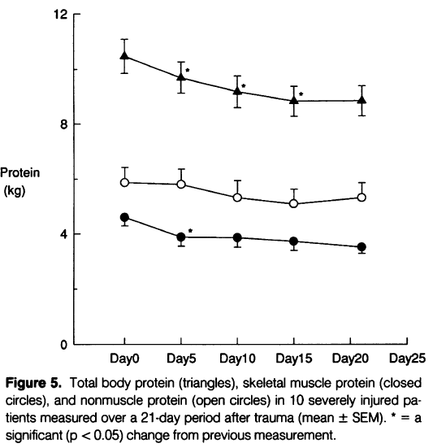
Critically injured trauma patients during 21 days
Loss of skeletal muscle protein = loss of function
Monk DN, et al. Annals of surgery 1996; 223:395-405.

Slide 6

Low muscularity or Muscle Atrophy in the critically ill can lead to…
Physical Dysfunction
  Risk of falls / Potential fractures
  Impaired ability to perform ADL
  Functional disabilities
Metabolic Disorders
  Glycemic dysregulation
  Dyslipidemia
Immune dys-function
  Infection
  Complications
Poor Clinical Outcomes
  Mortality
  ICU LOS / Hospital LOS
  Hospital Complications
Notes:
Several metabolic/physiologic problems are related to muscle atrophy or low muscularity.

Slide 7
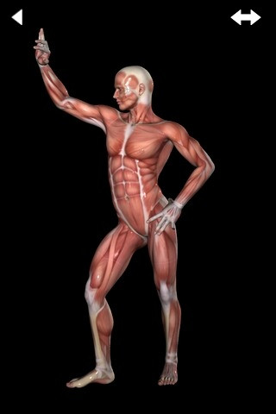
Role of Macronutrients in Preserving Mucle and Optimizing Outcomes

Slide 8

Does increasing protein delivery impact outcomes?

Slide 9
What happens to exogenously administered amino acid?
Olav Rooyakers CC. icu-metabolism.se

Slide 10
Effect on Nitrogen Balance?
249 trauma patients receiving nutrition support
Dickerson J Trauma Acute Care Surg 2012

Slide 11
What is the evidence that exogenously administered amino acids/protein favorably impacts muscle mass?

Slide 12
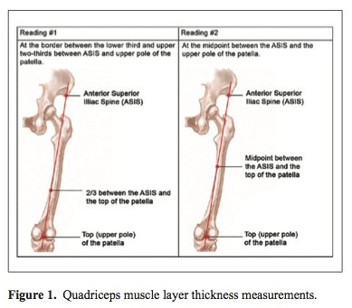
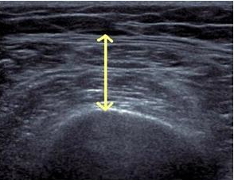
Bedside Measure of Muscle Mass
Tillquist et al JPEN 2013
Gruther et al J Rehabil Med 2008
Campbell et al AJCN 1995

Slide 13
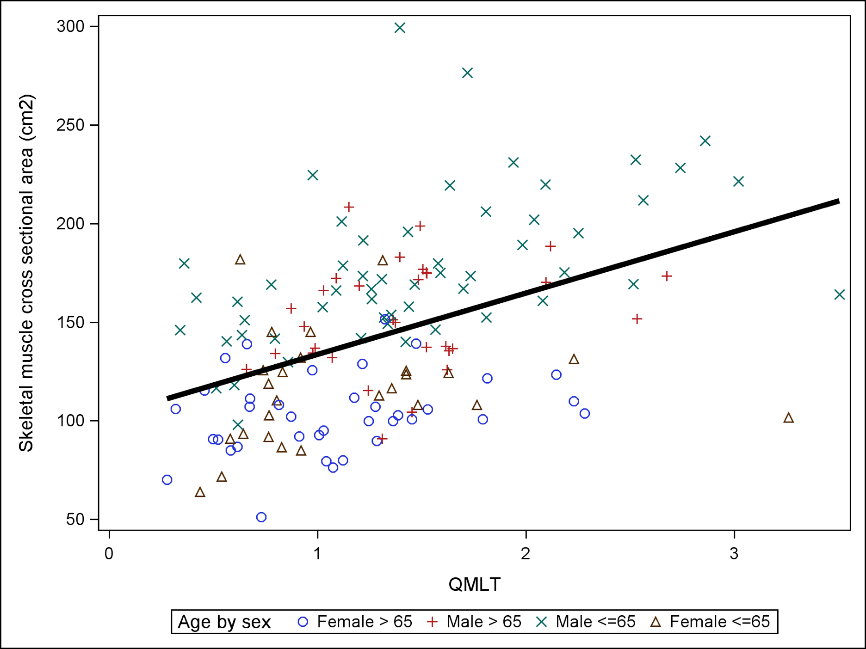
Association between CT skeletal muscle measure and US thickness of quadraceps
Pearson correlation coefficient = 0.45; P<0.0001
Paris JPEN 2016
Notes:
Legend: Association between CT skeletal muscle cross sectional area and ultrasound QMLT with linear regression lines superimposed. Overall regression fit: CT skeletal muscle cross sectional area=102.5+31.1*QMLT. Overall Pearson correlation coefficient between CT skeletal muscle cross sectional area and Ultrasound QMLT index is 0.45, p<0.0001
Correlations were performed on each group but only males <65 yrs showed r=0.51 and P<0.05 (however this is likely driving the entire regression; n=?? but broad spectrum of muuscularity)
*Note: included 4 separate groups on the plot (young female, elderly female, young male, elderly male)
Groups
n
Pearson correlation coefficient
p values
Elderly males (≥ 65 yrs)
31
0.24
0.19
Young males (<65 yrs)
55
0.51
<0.0001
Elderly females (≥ 65 yrs)
37
0.26
0.12
Young females (<65 yrs)
26
0.13
0.52

Slide 14
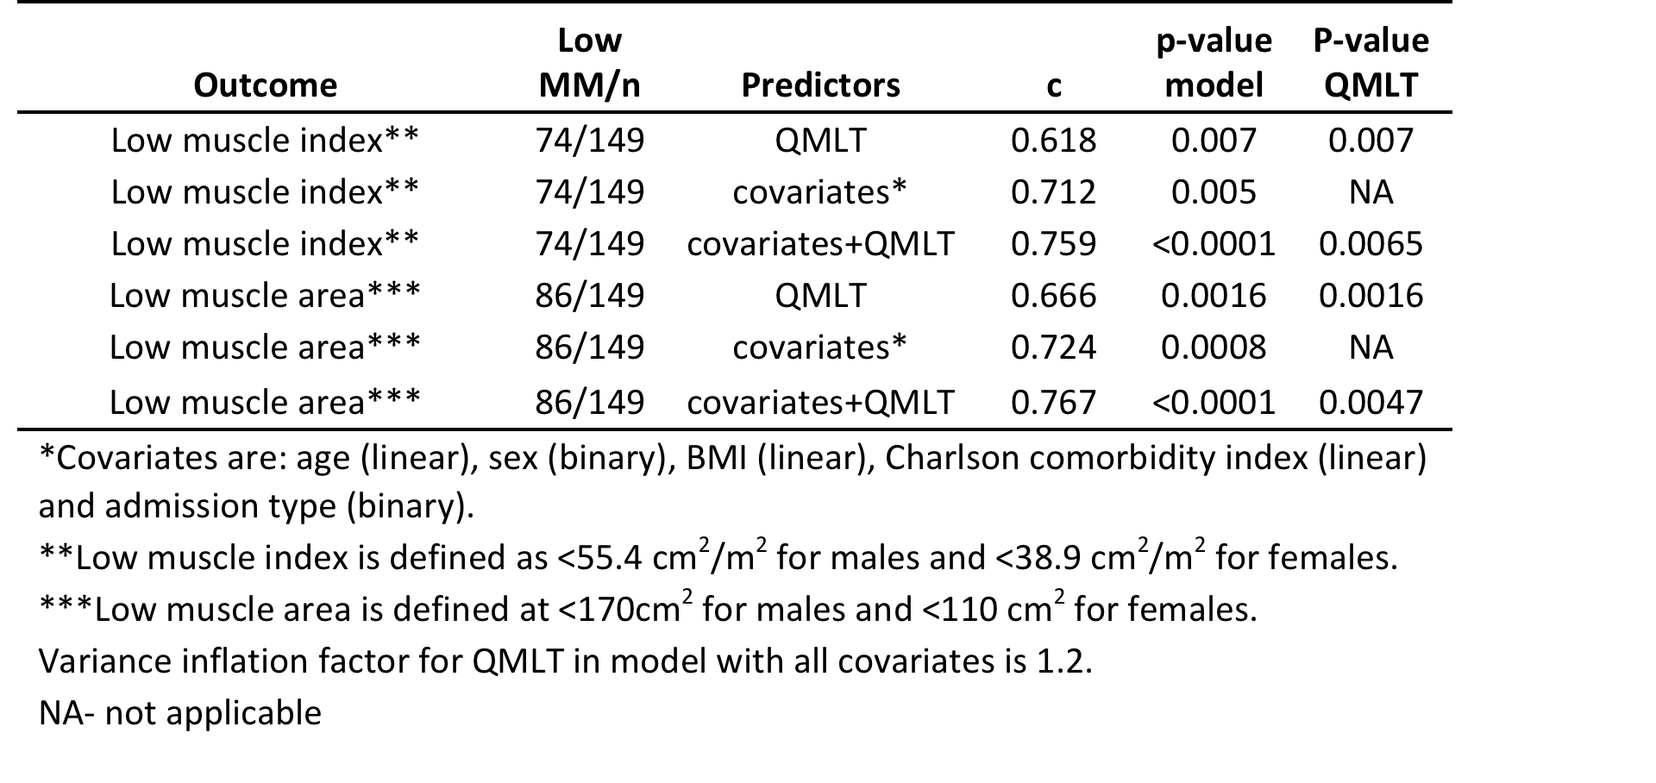
Ability of QMLT to predict low CT skeletal muscle index and CSA by logistic regression
Paris JPEN 2016
Notes:
Model is considered reasonable when c>0.7; strong when c>0.8 – moderately strong when combined covariates and QMLT – similar to previous slide using linear regression

Slide 15

Longitudinal changes in quadriceps thickness & impact on self-reported physical function following traumatic brain injury
Chapple (in press)

Slide 16

Relationship between anthropometry and self-reported outcomes:
Quad thickness correlated positively:
  SF-36 physical component summary score at 3-months at hospital discharge (r=0.536, p=0.010) and at 3-months (r=0.658, p=0.020).
  GOS-E at hospital discharge (r=0.595, p=0.003), and at 3-months (r=0.642, p=0.025)
Chapple (in press)

Slide 17
What is the evidence that exogenously administered amino acids/protein favorably impacts clinical outcomes?

Slide 18
Impact of Protein Intake on
60-day Mortality
Data from 2828 patients from 2013 International Nutrition Survey
 | Patients in ICU ≥ 4 d
Variable | 60-Day Mortality, Odds Ratio (95% CI)
 |  | Adjusted¹ | Adjusted²
Protein Intake (Delivery > 80% of prescribed vs. < 80%) |  | 0.61 (0.47, 0.818) | 0.66 (0.50, 0.88)
Energy Intake (Delivery > 80% vs. < 80% of Prescribed) |  | 0.71 (0.56, 0.89) | 0.88 (0.70, 1.11)
¹ Adjusted for BMI, Gender, Admission Type, Age, Evaluable Days, APACHE II Score, SOFA Score
² Adjusted for all in model 1 plus for calories and protein
Nicolo JPEN 2015

Slide 19
Rate of Mortality Relative to
Adequacy of Protein and Energy Intake Delivered
Current practice
0.7 gm/kg
Minimally acceptable
1.2 gm/kg
Ideal practice?
>1.5 gm/kg
Heyland JPEN 2015

Slide 20
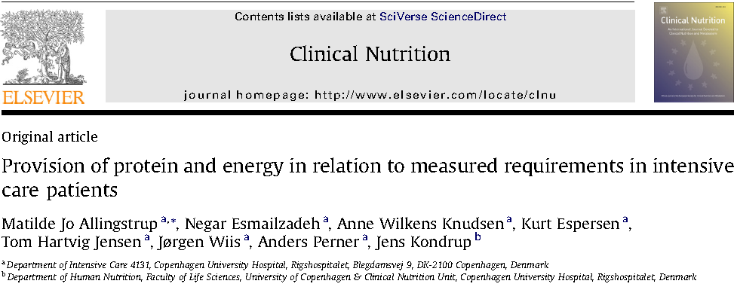
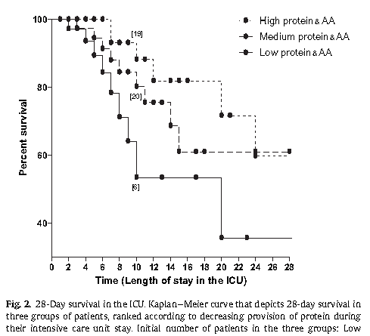
113 select ICU patients with sepsis or burns
On average, receiving 1900 kcal/day and 84 grams of protein
No significant relationship with energy intake but……
1.45 gm/kg/d
1.06 gm/kg/d
0.79 gm/kg/d
Clinical Nutrition 2012

Slide 21

More Protein Associated with Improved Clinical Outcomes!
If you feed them (better!)
They will leave (sooner!)

Slide 22

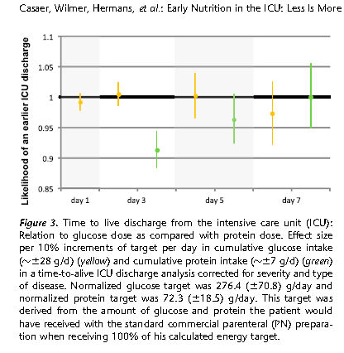
Early Nutrition in the ICU: Less is more!
Post-hoc analysis of EPANIC
Indication bias:
1) patients with longer projected stay would have been fed more aggressively; hence more protein/calories is associated with longer lengths of stay. (remember this is an unblinded study).
2) 90% of these patients are elective surgery. there would have been little effort to feed them and they would have categorically different outcomes than the longer stay patients in which their were efforts to feed
Protein is the bad guy!!
Casaer Am J Respir Crit Care Med 2013;187:247–255

Slide 23
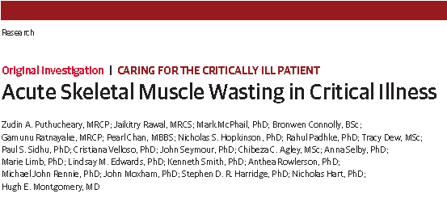
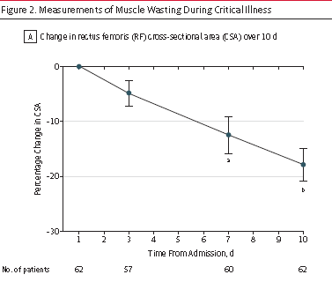
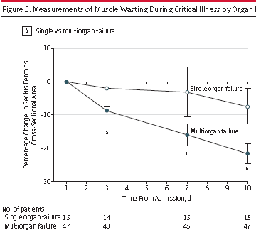
JAMA Published online Oct 9, 2013

Slide 24
“In a multivariable linear analysis, change in rectus femoris CSA was positively associated with the degree of organ failure, CRP level and amount of protein delivered”
JAMA Published online Oct 9, 2013

Slide 25
78 patient with ALI randomized to Intensive Medical therapy (30 kcal/kg/day) or usual care (40-60% of target)
Stopped early because of excess deaths in intensive group
Post hoc analysis suggests increased death from early protein!

Slide 26
More Protein Associated with Improved Clinical Outcomes?
If you feed them (better!)
They will leave (sooner!)

Slide 27
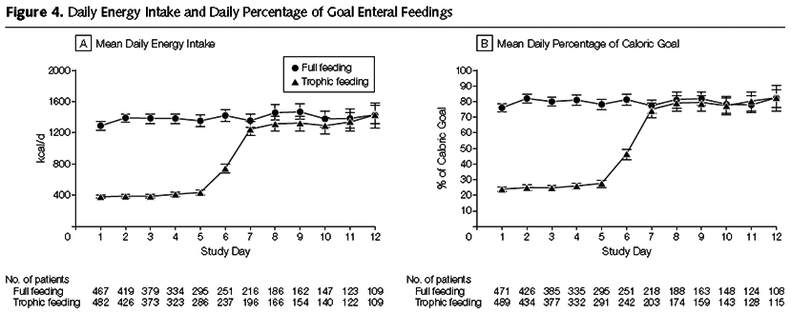
Initial Tropic vs. Full EN in Patients with Acute Lung Injury
The EDEN randomized trial
Rice TW, et al. JAMA. 2012;307(8):795-803.

Slide 28
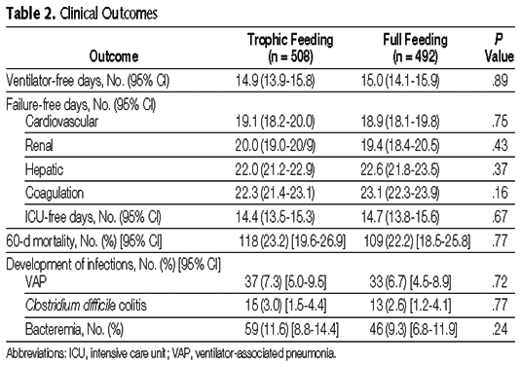
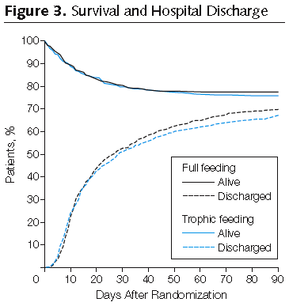
Initial Tropic vs. Full EN in Patients with Acute Lung Injury
The EDEN randomized trial
Rice TW, et al. JAMA. 2012;307(8):795-803.

Slide 29
SHOULD WE SYSTEMATICALLY UNDERFEED ALL ICU PATIENTS?

Slide 30
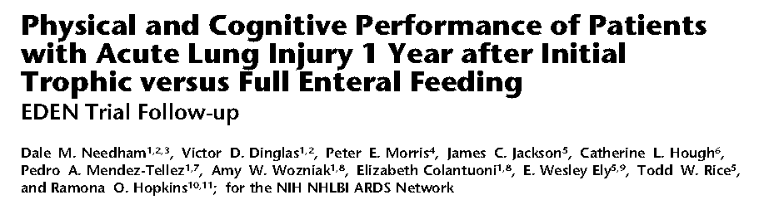
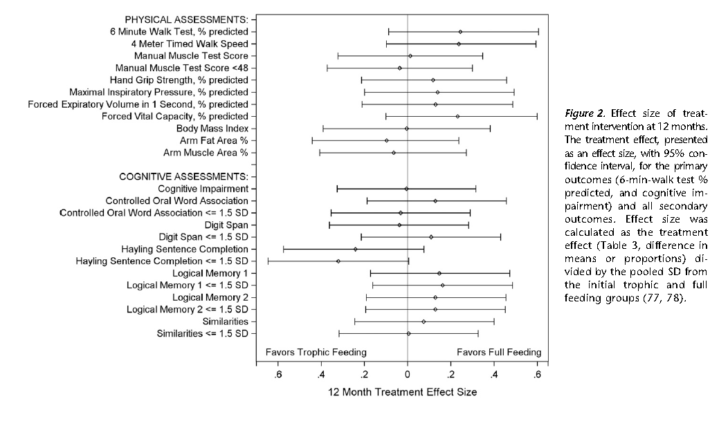

Slide 31
Nutritional Adequacy and Long-term Outcomes in Critically Ill Patients Requiring Prolonged Mechanical Ventilation
Sub study of the REDOXS study
302 patients survived to 6-months follow-up and were mechanically ventilated for more than eight days in the intensive care unit were included.
Nutritional adequacy was obtained from the average proportion of prescribed calories received during the first eight days of mechanical ventilation in the ICU.
HRQoL was prospectively assessed using Short-Form 36 Health Survey (SF-36) questionnaire at three-months and six-months post ICU admission.
Wei CCM 2015

Slide 32
Estimates of Association Between Nutritional Adequacy and SF-36 Scores
SF-36 |  | Adjusted Estimate* (95% CI) | p-value
Physical Functioning | 3-month (n=179) | 7.29 (1.43, 13.15) | 0.02
 | 6-month (n=202) | 4.16 (-1.32, 9.64) | 0.14
Role Physical | 3-month (n=178) | 8.30 (2.65, 13.95) | 0.004
 | 6-month (n=202) | 3.15 (-2.25, 8.54) | 0.25
Physical Component Scale | 3-month (n=175) | 1.82 (-0.18, 3.81) | 0.07
 | 6-month (n=200) | 1.33 (-0.65, 3.31) | 0.19
*Every 25% increase in nutritional adequacy; adjusted for age, APACHE II score, baseline SOFA, Functional Comorbidity Index, admission category, primary ICU diagnosis, body mass index, and region
Wei CCM 2015

Slide 33
So if we trophic feeds x days, it is possible that we are harming some ICU patients, particularly those with long ICU stays?

Slide 34
The Nephroprotect Study
RCT short-term daily IV aa on kidney function in critical illness, compared to standard care.
Unblinded
All patients expected to remain 48 hrs; excluded patients with AKI
Max protein intake total of 2.0 gm/kg/day (IBW)
More patient in Intervention group with:
  Higher APACHE II severity of illness scores (20.2 ± 6.8 vs. 21.7 ± 7.6, P = 0.02)
  pre-existing renal dysfunction (29/235 vs. 44/239, P = 0.07)
Doig Int Care Med 2015

Slide 35
The Nephroprotect Study
Doig Int Care Med 2015

Slide 36
The Nephroprotect Study
P=0.004
No difference in any other renal or clinical outcome
No impact on survival or HRQOL
Doig Int Care Med 2015

Slide 37
So how do we put this all together?

Slide 38
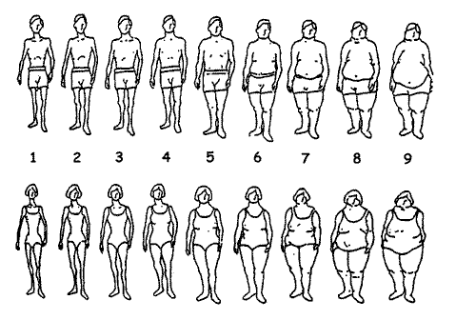
ICU patients are not all created equal…should we expect the impact of nutrition therapy to be the same across all patients?

Slide 39
A Conceptual Model for Nutrition Risk Assessment in the Critically Ill
Acute
Reduced po intake
pre ICU hospital stay
Chronic
Recent weight loss
BMI?
Starvation
Nutrition Status
micronutrient levels - immune markers - muscle mass
Inflammation
Acute
IL-6
CRP
PCT
Chronic
Comorbid illness

Slide 40
The Development of the NUTrition Risk in the Critically ill Score (NUTRIC Score).
Variable | Range | Points
Age | <50 | 0
 | 50-<75 | 1
 | >=75 | 2
APACHE II | <15 | 0
 | 15-<20 | 1
 | 20-28 | 2
 | >=28 | 3
SOFA | <6 | 0
 | 6-<10 | 1
 | >=10 | 2
# Comorbidities | 0-1 | 0
 | 2+ | 1
Days from hospital to ICU admit | 0-<1 | 0
 | 1+ | 1
IL6 | 0-<400 | 0
 | 400+ | 1
AUC | 0.783
Gen R-Squared | 0.169
Gen Max-rescaled R-Squared | 0.256
BMI, CRP, PCT, weight loss, and oral intake were excluded because they were not significantly associated with mortality or their inclusion did not improve the fit of the final model.

Slide 41
The Validation of the NUTrition Risk in the Critically ill Score (NUTRIC Score)
Interaction between NUTRIC Score and nutritional adequacy (n=211)*
P value for the interaction=0.01
Heyland Critical Care 2011, 15:R28

Slide 42
The Validation of the NUTrition Risk in the Critically ill Score (NUTRIC Score)
Validated in 3 separate databases including the INS Dataset involving over 200 ICUs worldwide ^{1,2,3}
Validated without IL-6 levels (modified NUTRIC) ²
Independently validated in Brazilian, Portuguese, and Asian populations ^{4,5,6}
Not validated in post hoc analysis of the PERMIT trial ⁷
  RCT of different caloric intake (protein more important)
  Underpowered, very wide confidence intervals
4. Rosa Clinical Nutrition ESPEN 2016
5. Mendes J Crit Care 201
6. Mukhopadhyay Clinical Nutrition 2016
7. Arabi AmJRCCM 2016
Heyland Critical Care 2011, 15:R28
Rahman, Clinical Nutrition 2015
Compher, CCM, 2016 (in press)

Slide 43
Who might benefit the most from protein intervention?
Ans: “high-risk patients”
High NUTRIC Score
Clinical
  BMI
  Projected long length of stay
  Nutritional history variables
Sarcopenia
  CT vs. bedside US
Others?

Slide 44
More Protein is Better!
Particularly in ‘High-risk’ patients
If you feed them (better!)
They will leave (sooner!)

Slide 46
Current Practice
Results of 2014 INS
What are people prescribing currently?
Majority use actual or estimated dry weight
site
All US sites
All sites
63 sites in US (Sister Sites)
186 sites worldwide
Notes:
Need data on use of protein supplements and percent with feeding protocols

Slide 47
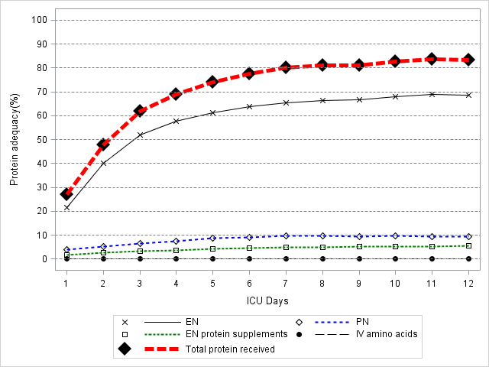
Current Practice
Results of 2014 INS
Overall Adequacy 55%
Source of Protein
83% from EN
11.5% from PN
6% from enteral protein supplements
<1% from IV amino acids alone
Notes:
Need data on use of protein supplements and percent with feeding protocols

Slide 48
Current Practice
Results of 2014 INS
In all comers:
At a patient level, 16% of patients averaged more than 80% protein adequacy
At a site level, 6% (11 sites) averaged more than 80% in all patients.
In High NUTRIC patients:
16% of high NUTRIC Score patients received more than 80% of prescribed amount.
7% (16 sites) managed to provide more than 80% of prescribed amounts to high-risk patients.
Performance in ‘all’ patients same as High NUTRIC patients

Slide 49
Is current practice providing adequate amounts of protein to critically ill patients?

Slide 50
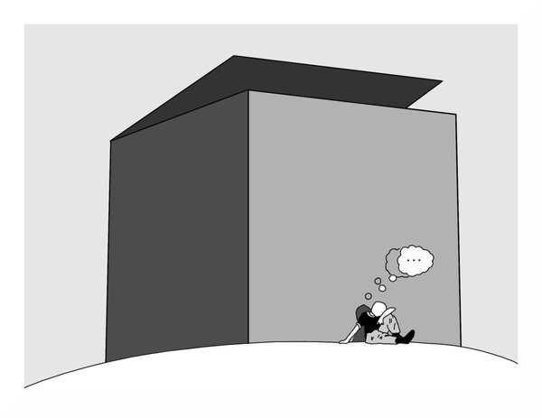
Can we do better?
The same thinking that got you into this mess won’t get you out of it!

Slide 51

The Efficacy of Enhanced Protein-Energy Provision via the Enteral Route in Critically Ill Patients:
The PEP uP Protocol!
Different feeding options based on hemodynamic stability and suitability for high volume intragastric feeds.
In select patients, we start the EN immediately at goal rate, not at 25 ml/hr.
We target a 24 hour volume of EN rather than an hourly rate and provide the nurse with the latitude to increase the hourly rate to make up the 24 hour volume.
Start with a semi elemental solution, progress to polymeric
Tolerate higher GRV threshold (300 ml or more)
Motility agents and protein supplements are started immediately, rather than started when there is a problem.
A Major Paradigm Shift in How we Feed Enterally
Heyland Crit Care 2010;
see www.criticalcarenutrition.com for more information on the PEP uP collaborative

Slide 52
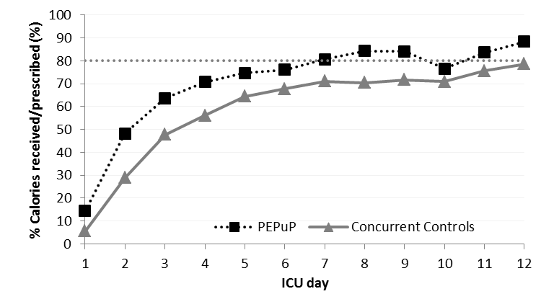
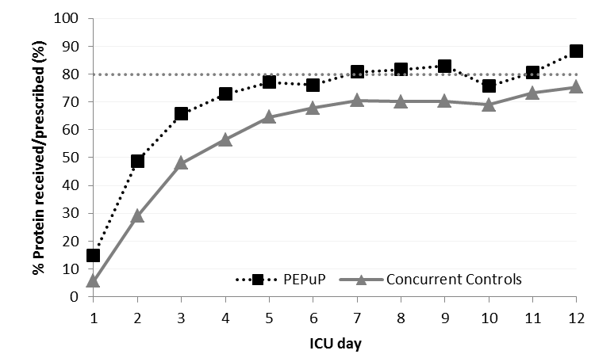
Results of the Canadian PEP uP Collaborative
Results of 2013 International Nutrition Survey
Heyland JPEN 2014

Slide 53
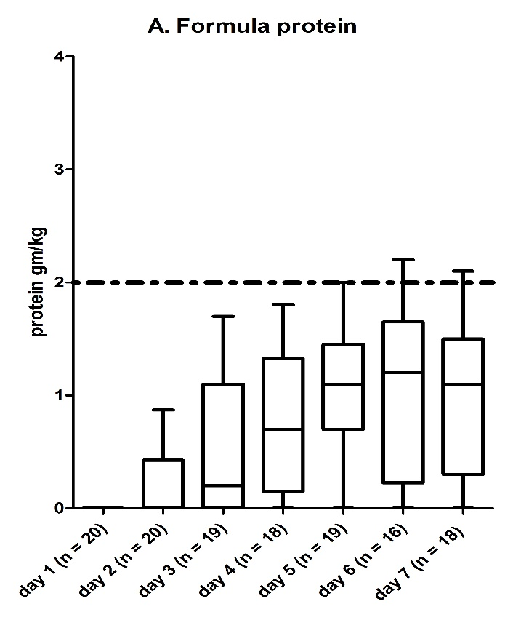
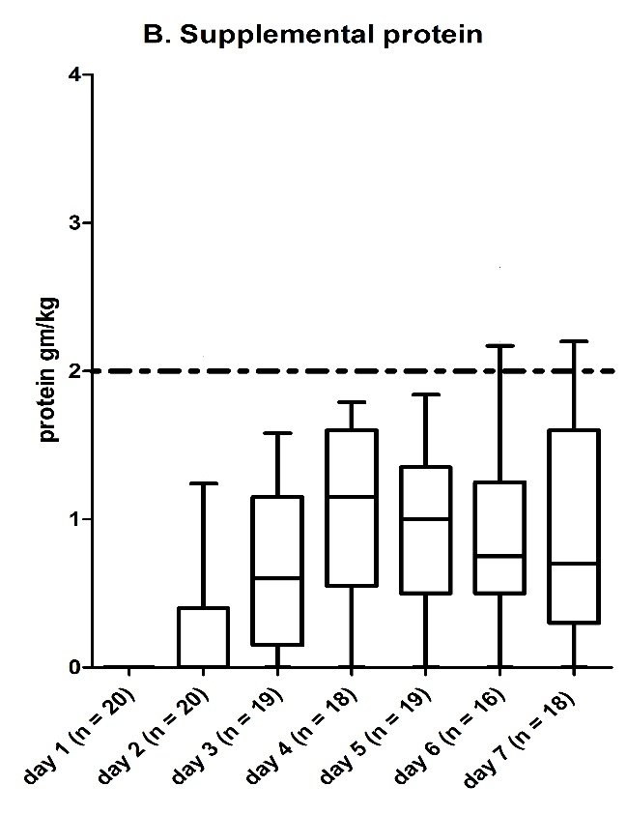
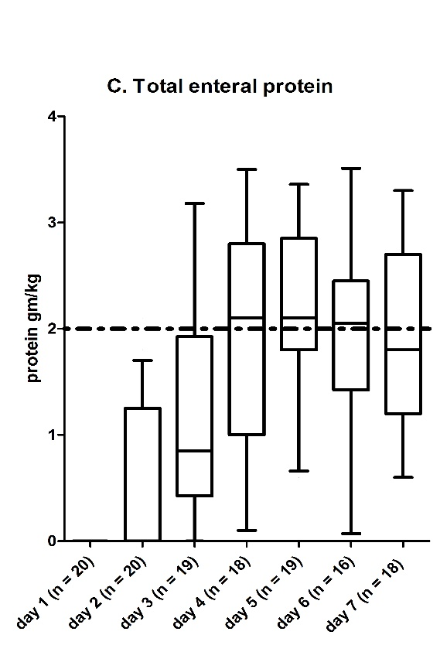
Effect of Protein Supplements q6h to a dose of 1 gm/kg/day
O’Keefe NCP (in press)

Slide 54
Results of Supplemental PN in Nutritionally High-risk ICU patients: The TOP UP Study
 | EN (n=71) | EN+PN (n=49) | Difference mean (95% CI) | p-value
Adequacy by EN route only
Calories first 27 days | 70±26 | 67±25 | -3 (-12 to 7) | 0.55
Calories first week | 68±28 | 68±27 | -1 (-11 to 9) | 0.91
Protein first 27 days | 66±26 | 60±23 | -5 (-14 to 3) | 0.23
Protein in first week | 63±26 | 61±25 | -3 (-12 to 7) | 0.57
Adequacy by EN or PN route
Calories first 27 days | 72±25 | 90±16 | 18 (11 to 25) | <.001
Calories first week | 69±28 | 95±13 | 26 (18 to 34) | <.001
Protein first 27 days | 68±25 | 82±19 | 13 (6 to 21) | <.001
Protein in first week | 64±26 | 86±16 | 22 (14 to 29) | <.001
Yet to be published data

Slide 55
Nutrition and EXercise Interventional Study in critically ill patients
The NEXIS study
Bedside cycling ergometry
and IV amino acids
(2-2.5 grams/kg/day)
142 ICU patients
Projected length of
stay >3 days
R
Concealed Stratified by
site
Fed enterally
Usual Care
(bed rest and underfeeding)
To be funded by NIH

Slide 56
The Effect of High versus Usual Protein Dosing in Critically Ill Patients:
A Multicenter Registry-based Randomized Trial
The EFFORT Trial
Target >2.0 gram/kg/day
Primary Outcome
ICU patients
R
Stratified by:
Site
BMI
Med vs Surg
Fed enterally
60 day
mortality
Nutric >5
Target <1.2 gram/kg/day
A multicenter, pragmatic, volunteer-driven, registry-based, randomized, clinical trial.

Slide 57
Other Strategies to Preserving Mucle and Optimizing Outcomes
HMB
Ghrelin agonists
Growth Hormone
Oxandrolone
IGF-1
others

Slide 58
Conclusions
Preserving muscle mass/function will facilitate optimal recovery of critically ill patients
Current protein is inadequate; some patients harmed!
Not all ICU patients the same
  NUTRIC Score may help identify those likely to benefit the most
Need to increase delivery of protein
  Enterally via PEP uP protocol
  More protein supplements
  IV aa or SPN
Combination of nutrition and exercise likely to have greatest treatment effect!

Slide 59
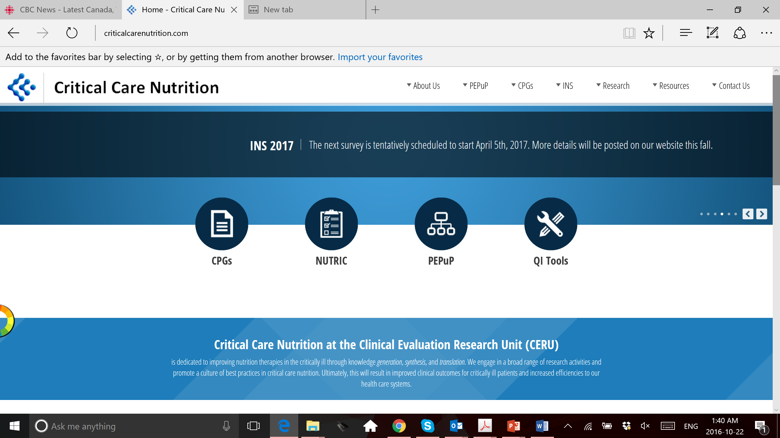


Slide 60
Questions?

